Slide 1
CREDIT CARD FRAUD
Anomaly Detection in R
Presentation to ABC Company Data Science Team by Mary Donovan Martello

Slide 2

Assignment/Results/Next Steps
Project Assignment: Design a binary classification model to predict whether ABC Company’s credit card transactions are fraudulent transactions.
Results: The One Class SVM (Recall of 90.72%) model is a viable classification model to classify ABC Company’s credit card account transactions as either fraudulent or non-fraudulent. Utilizing the k means clusters as features or labels in supervised models are also viable methods.
Next Steps: (1) improve models, (2) try different approaches to evaluating the models, (3) evaluate approaches to imbalanced data, (4) try different resampling methods for feature selection and supervised models, and (5) increase computing capacity.

Slide 3
Following CRISP-DM Stages
Data Understanding
Data Preparation
Modeling
Evaluation

Slide 4


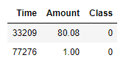
Dataset: ABC Company account information
PCA Components
Other Features:

Slide 5
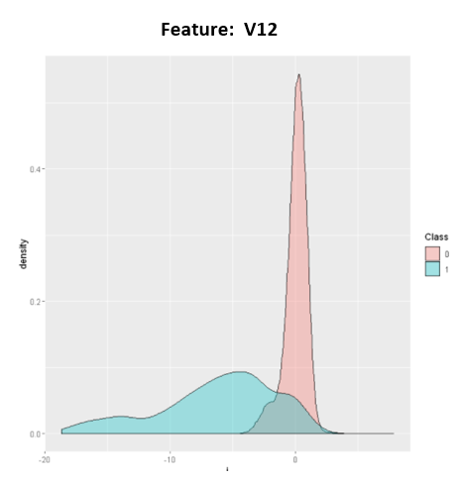
Data Understanding: Differences in Fraud Cases

Slide 6
Data Understanding: Variable Significance
The fraud target variable is highly imbalanced: 0 = Non-fraud (99.83%) and 1 = Fraud (0.17%). Resample for feature selection.
High
V4
V10
Medium
V2-V3
V5-V9
Time
Drop
V12
V14
V17
V1
V24
V11
V13
V15-V16
V18-V23
V25-V28

Slide 7
Modeling
Unsupervised Learning Methods Analyzed:
One Class SVM
K Means Clustering
DBSCAN Clustering
Methodology
Compare the unsupervised models with supervised models
Test each model with the Full Normal Dataset and the Select Feature Subset
Use original imbalanced data for unsupervised models and under sampled dataset for training data in supervised models
Use random sample of data because full dataset too large for computing

Slide 8
One Class Support Vector Machine Model
One Class SVM models are unsupervised because they train only on the positive records.
Only the fraud records used in training the model.
Use the trained model to make predictions on test data.
Test data includes both positive and negative fraud records.

Slide 9
Analysis of K Means Model
Elbow Method to determine optimal clusters
2 for Select Feature Subset
10 for Full Normal Subset
Analyzed the models in three ways: (1) visualization of the clusters, (2) using the clusters from a two-cluster model as the classification labels in a supervised model, and (3) adding the clusters to the dataset as a feature and training a supervised model with the clusters as a feature.

Slide 10
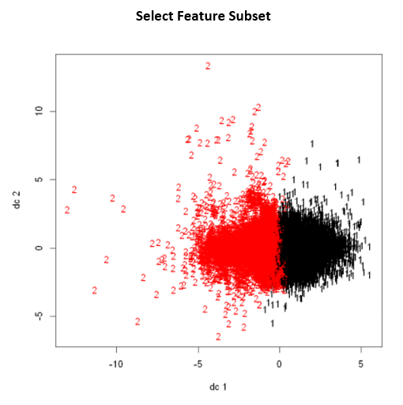
K Means Visualization
2 Cluster

Slide 11
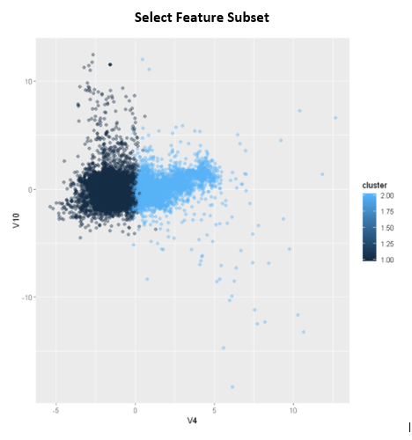
K Means Visualization
2 Cluster

Slide 12
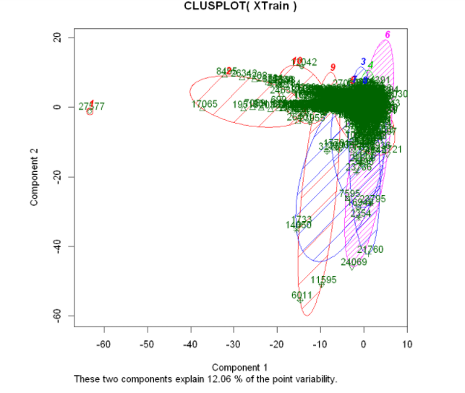
K Means Visualization
10 Cluster

Slide 13
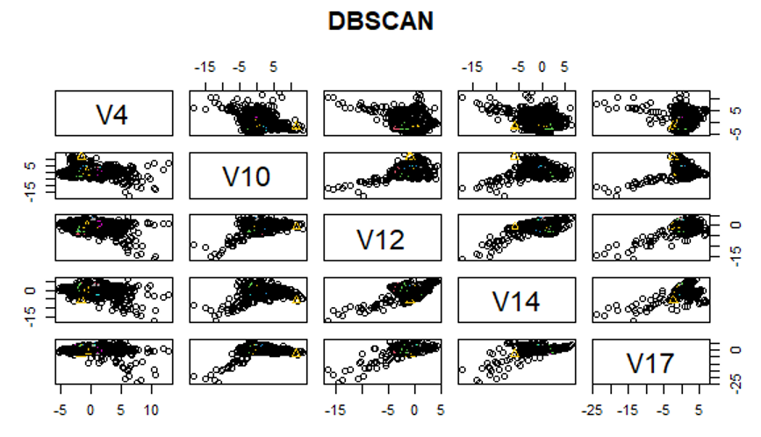
K Means Visualization

Slide 14
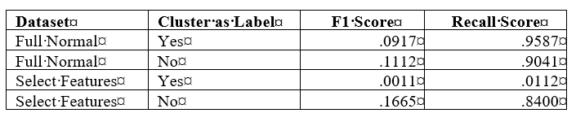
Evaluation
K Means Clusters as Classification Labels:

Slide 15
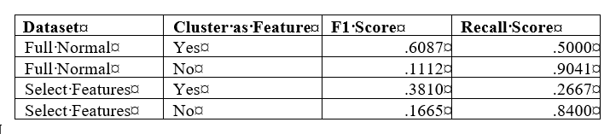
Evaluation
K Means Clusters as an Input Feature in Classification Model:

Slide 16
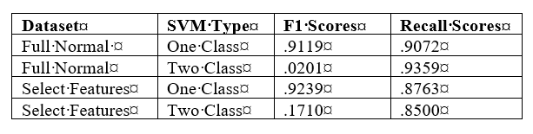
Evaluation
One Class Support Vector Machine:

Slide 17
Conclusion / Next Steps
Conclusion:
The unsupervised One Class SVM model is a viable model for predicting credit card frauds. Utilizing the k means clusters as features or labels in supervised models are also viable methods. The clustering visualization method will take more work to become viable prediction methods.
Next Steps:
(1) Tune hyperparameters for the models, (2) make probabilistic predictions based on optimizing the classification threshold, (3) implement a cost matrix for evaluation, (4) optimize balancing approach, and (5) improve computing capacity to be able to employ the full dataset.

